Slide 1
Multimedia Processor
ESE 345
Himanshu Goel
Wilmer Suarez

Slide 2
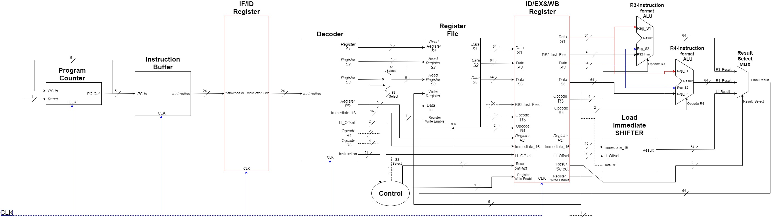
Multimedia Unit Block Diagram

Slide 3
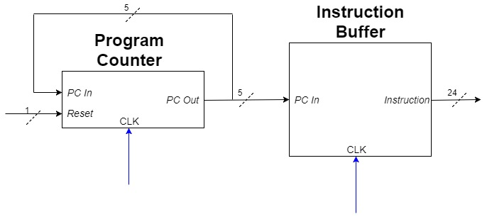
Program Counter and Instruction Buffer

Slide 4
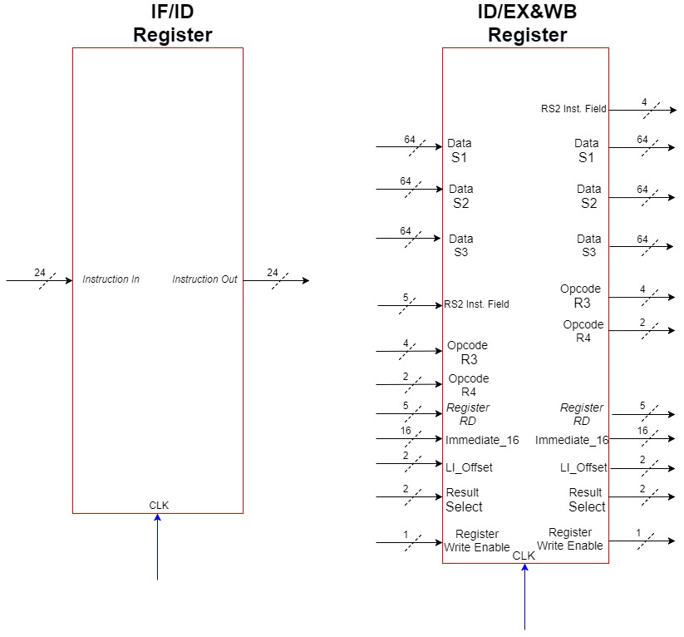
Pipeline Registers

Slide 5
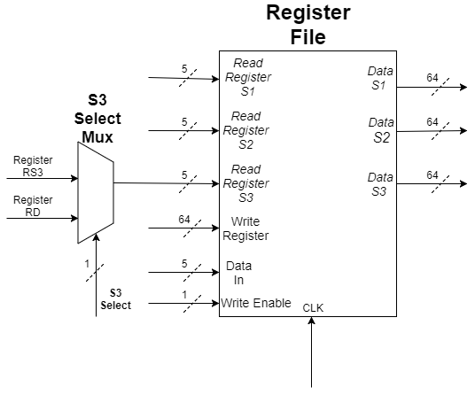
Register File

Slide 6
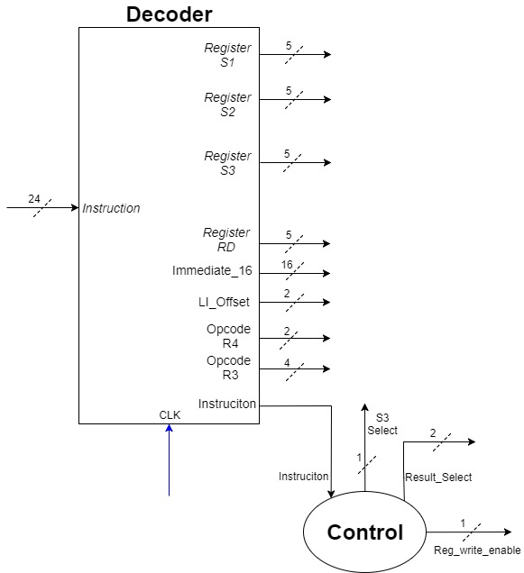
Instruction Decoder and Control Unit

Slide 7
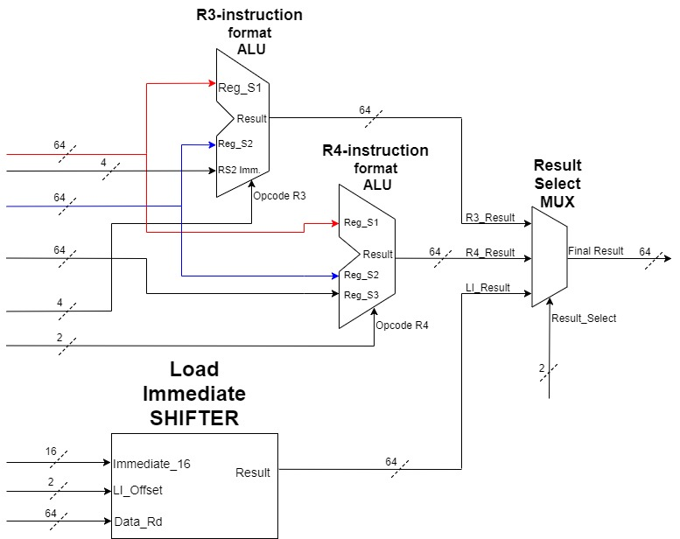
ALU 1, ALU 2 and Load Immediate Shifter

Slide 8
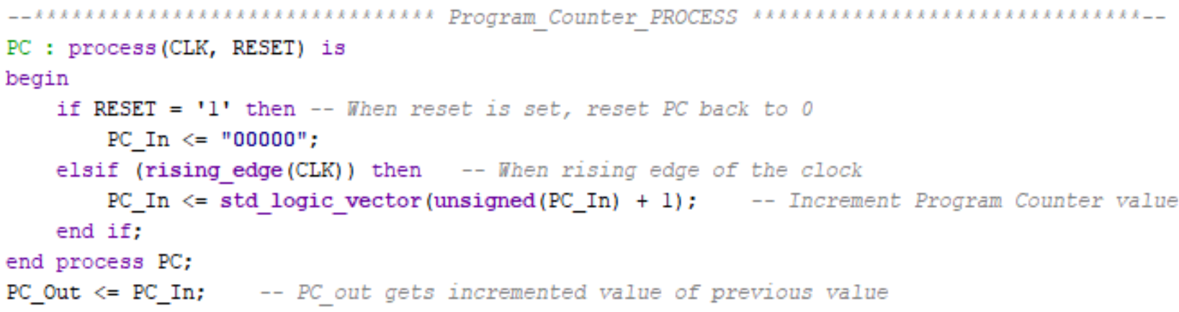
CODE
Program Counter

Slide 9
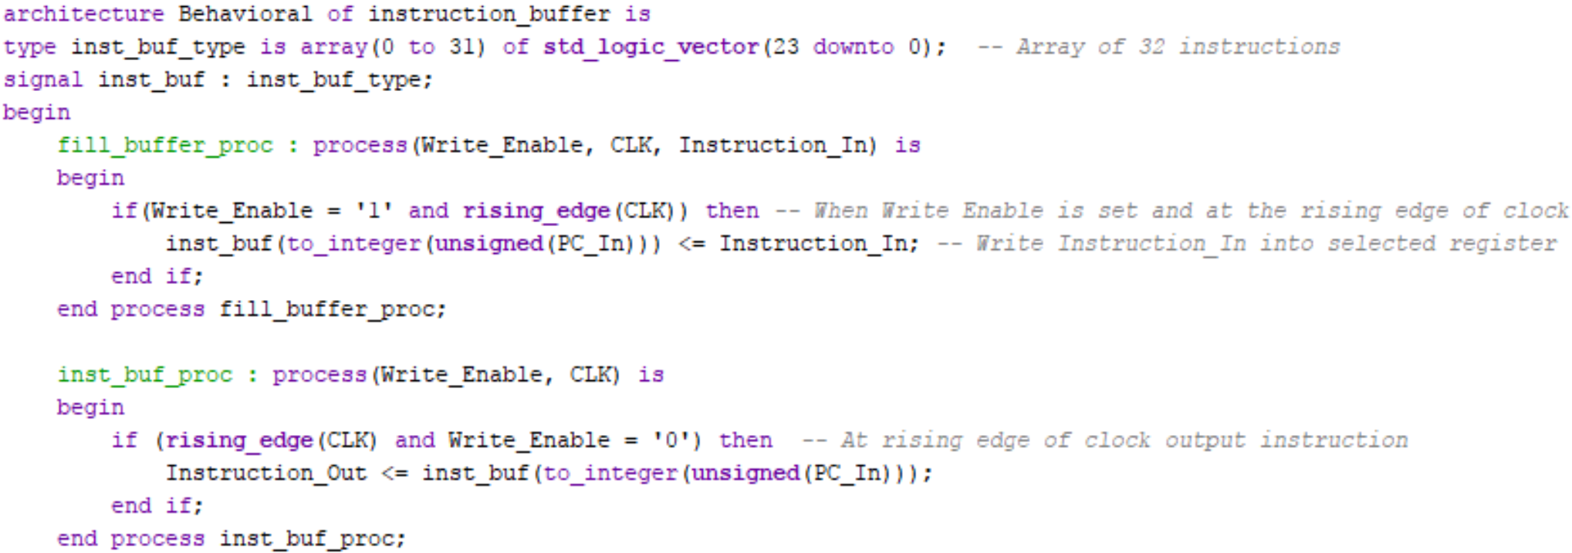
CODE
Instruction Buffer

Slide 10
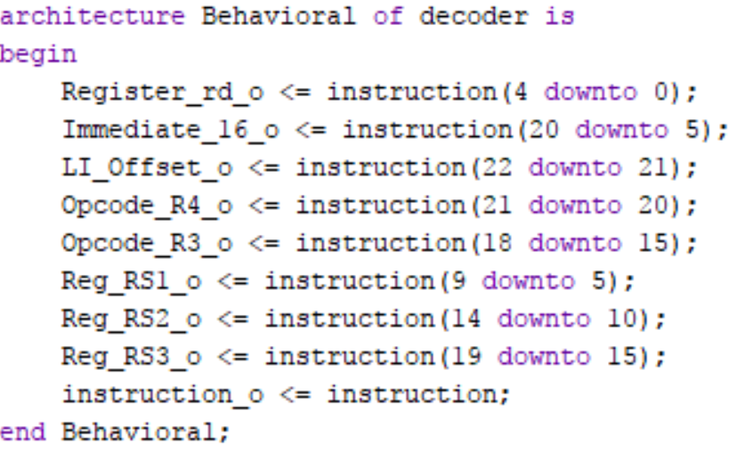
CODE
Instruction Decoder

Slide 11
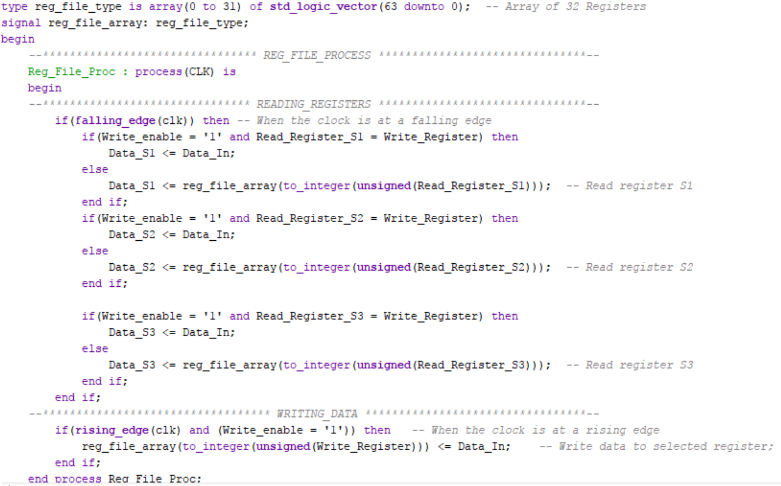
CODE
Register File

Slide 12
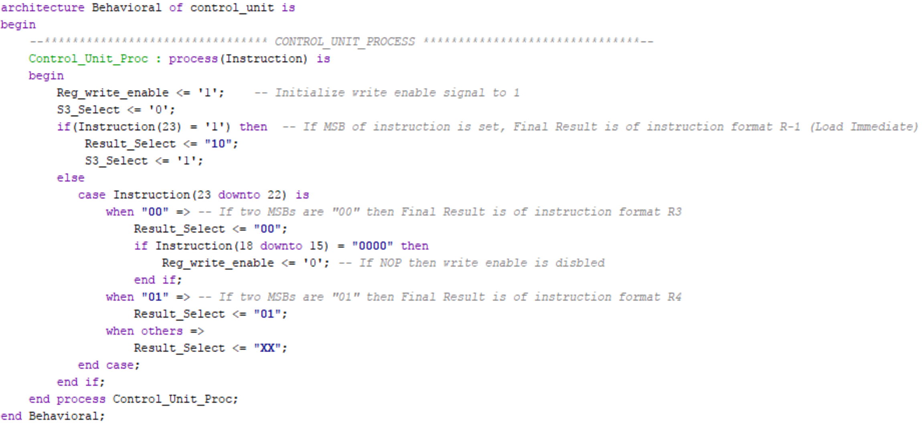
CODE
Control Unit

Slide 13
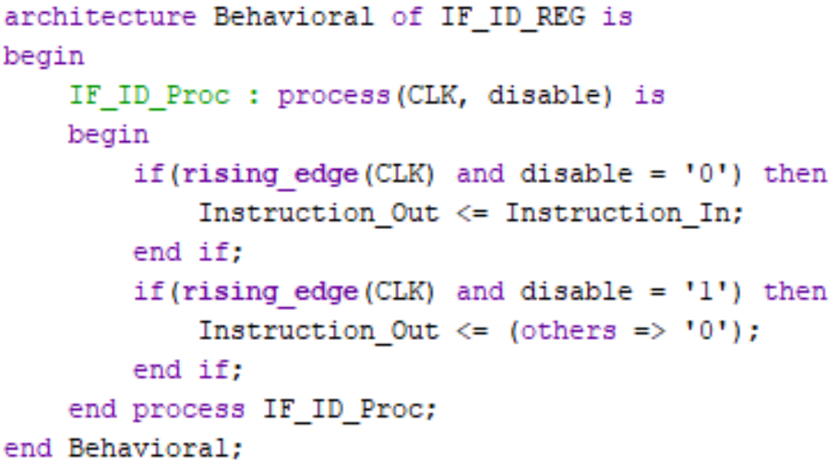
CODE
IF/ID Register

Slide 14
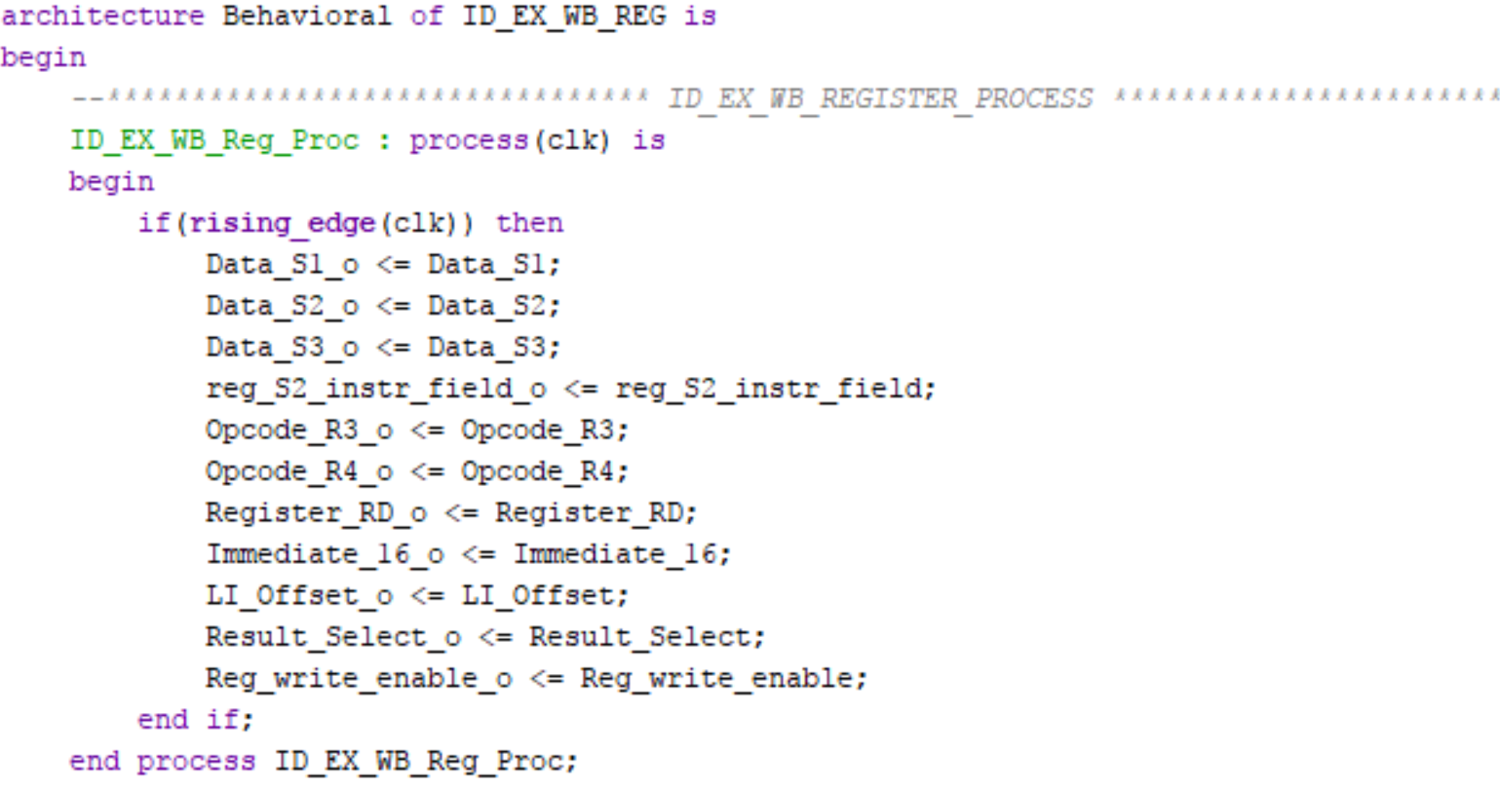
CODE
ID/EX&WB Register

Slide 15
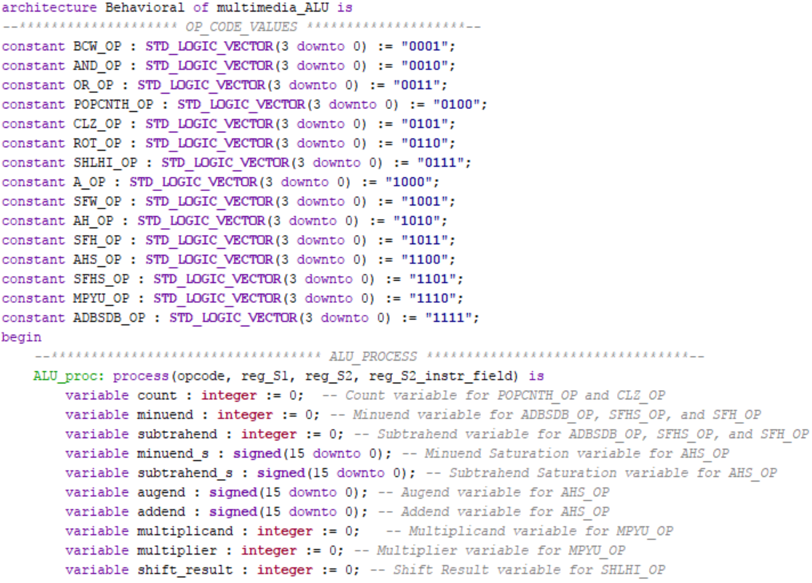
CODE
ALU 1

Slide 16
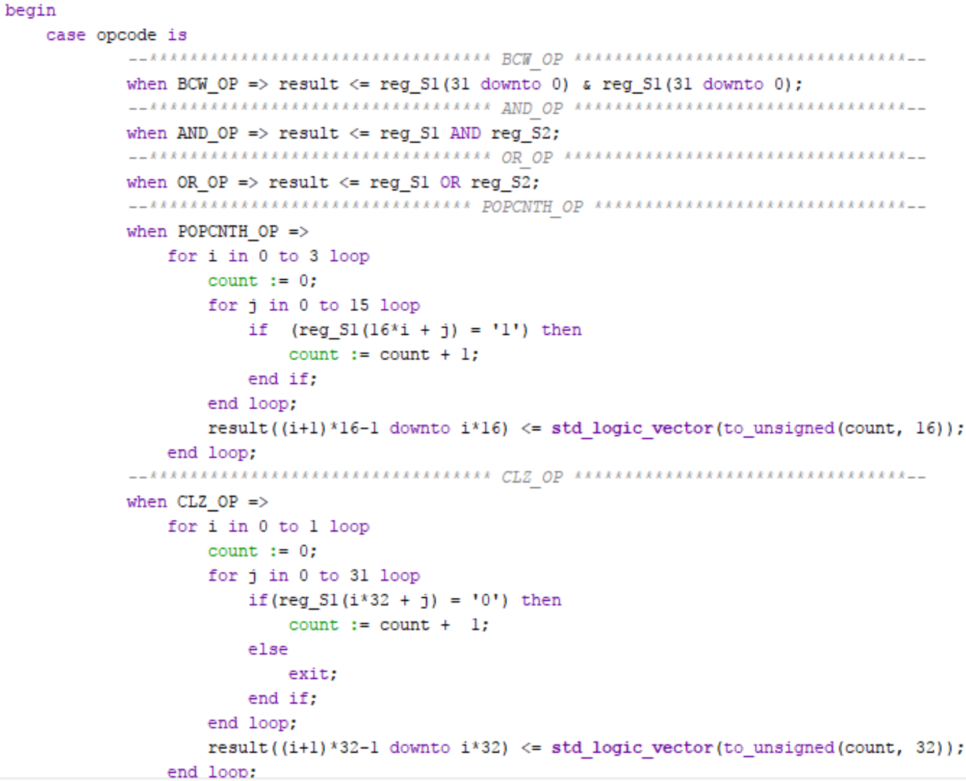
CODE
ALU 1

Slide 17
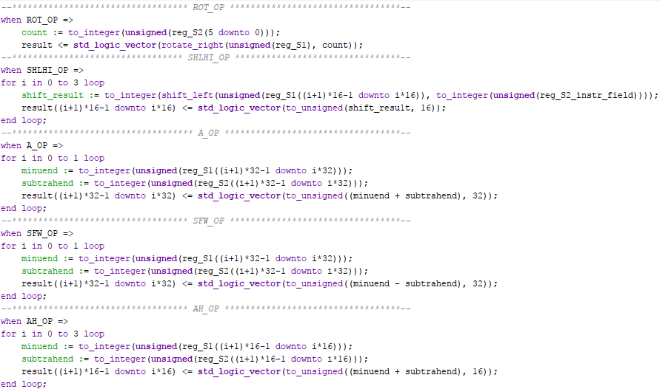
CODE
ALU 1

Slide 18
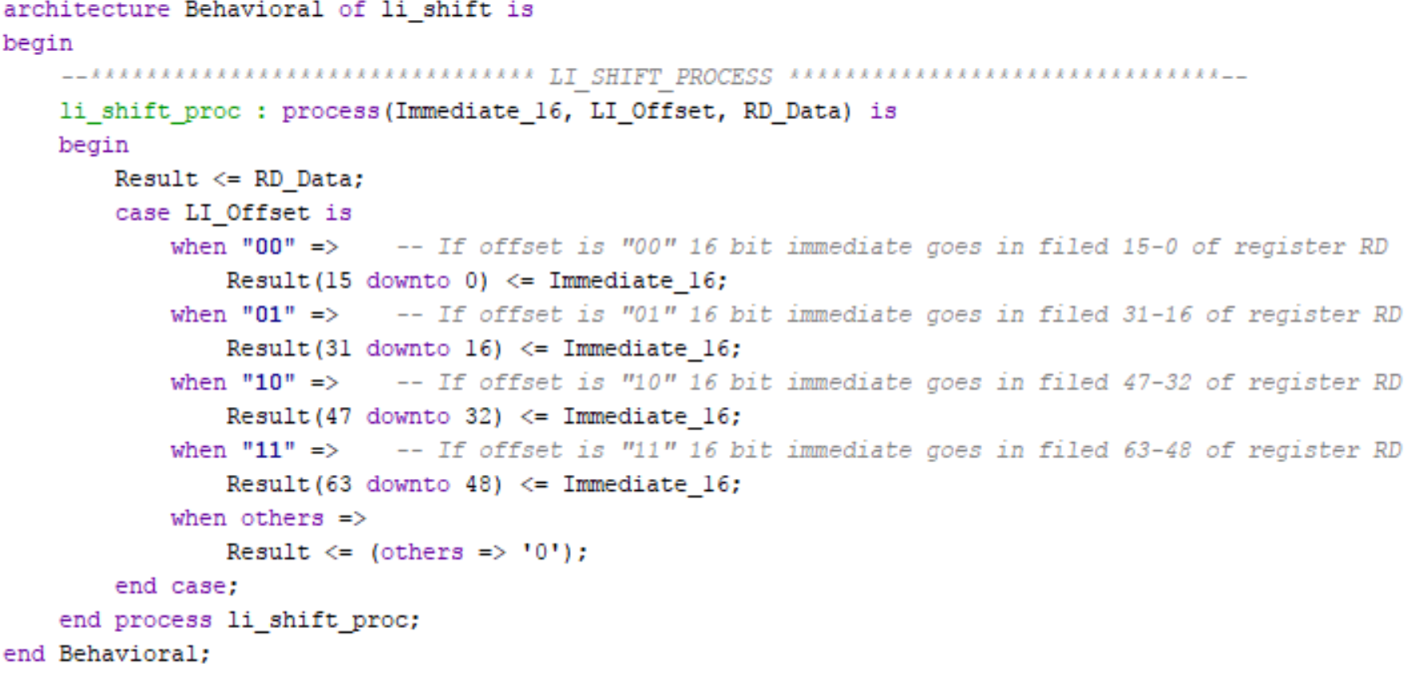
CODE
Load Immediate Shifter

Slide 19
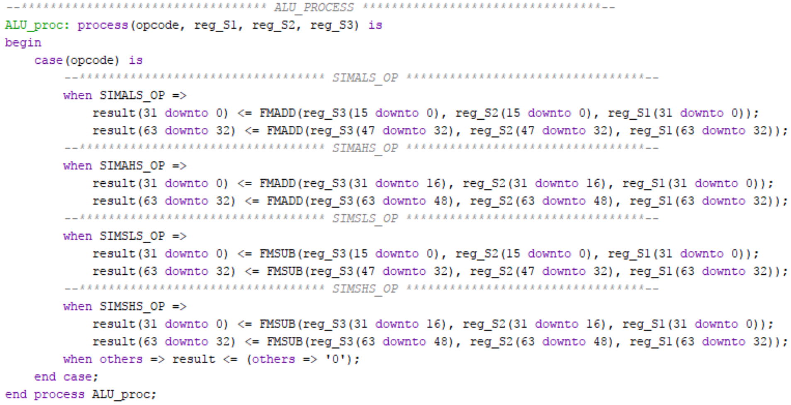
CODE
ALU 2

Slide 20
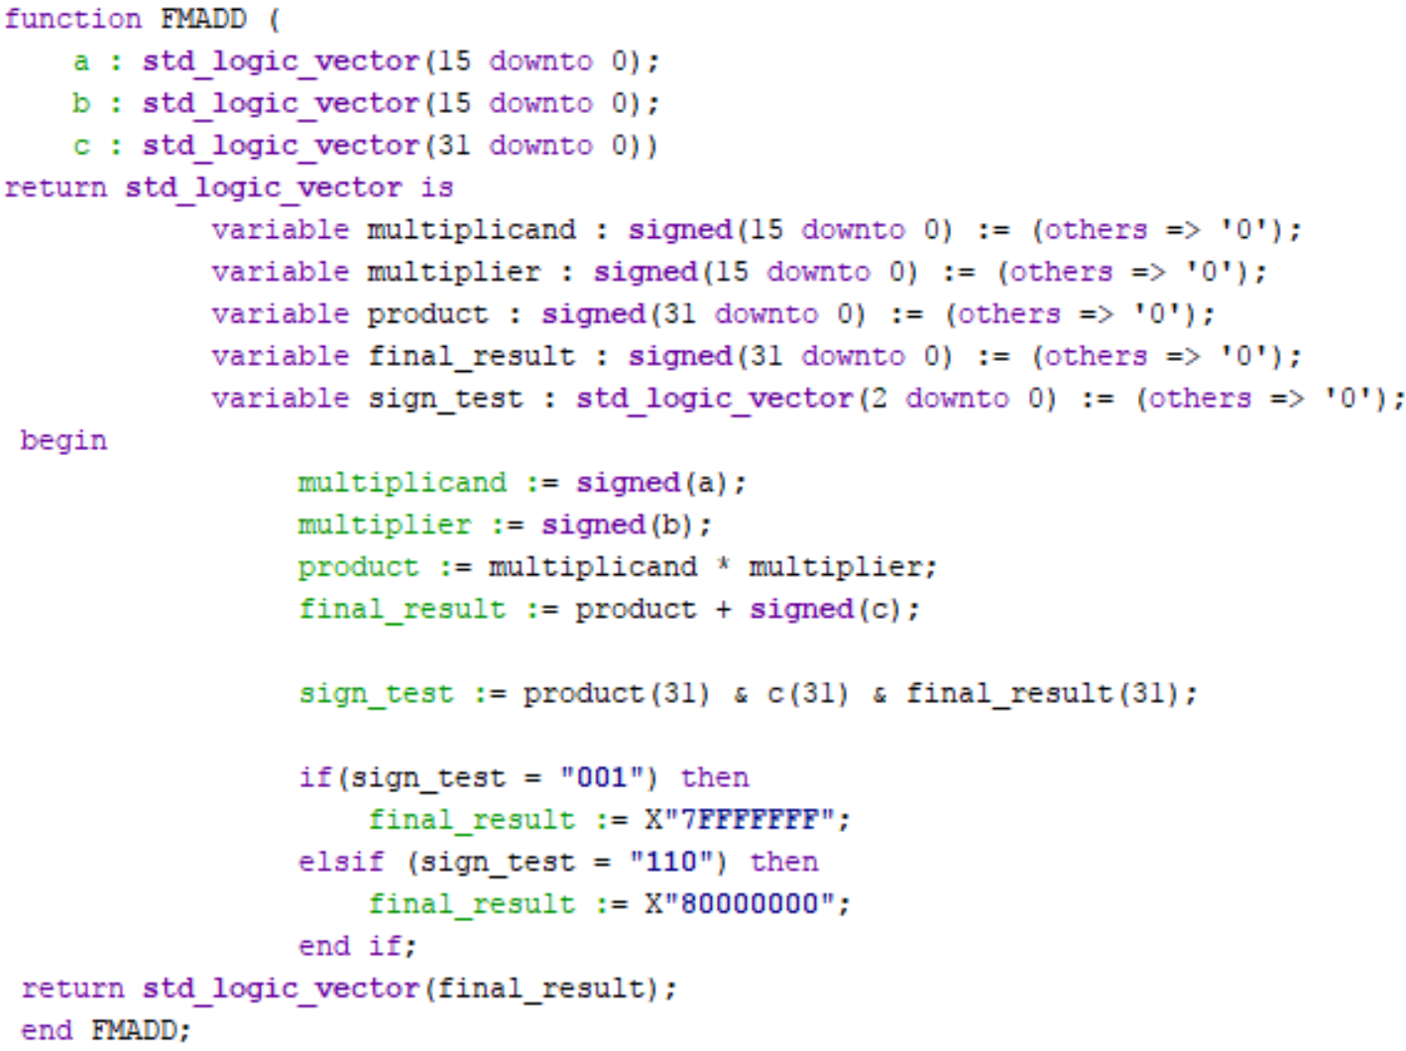
CODE
ALU 2

Slide 21
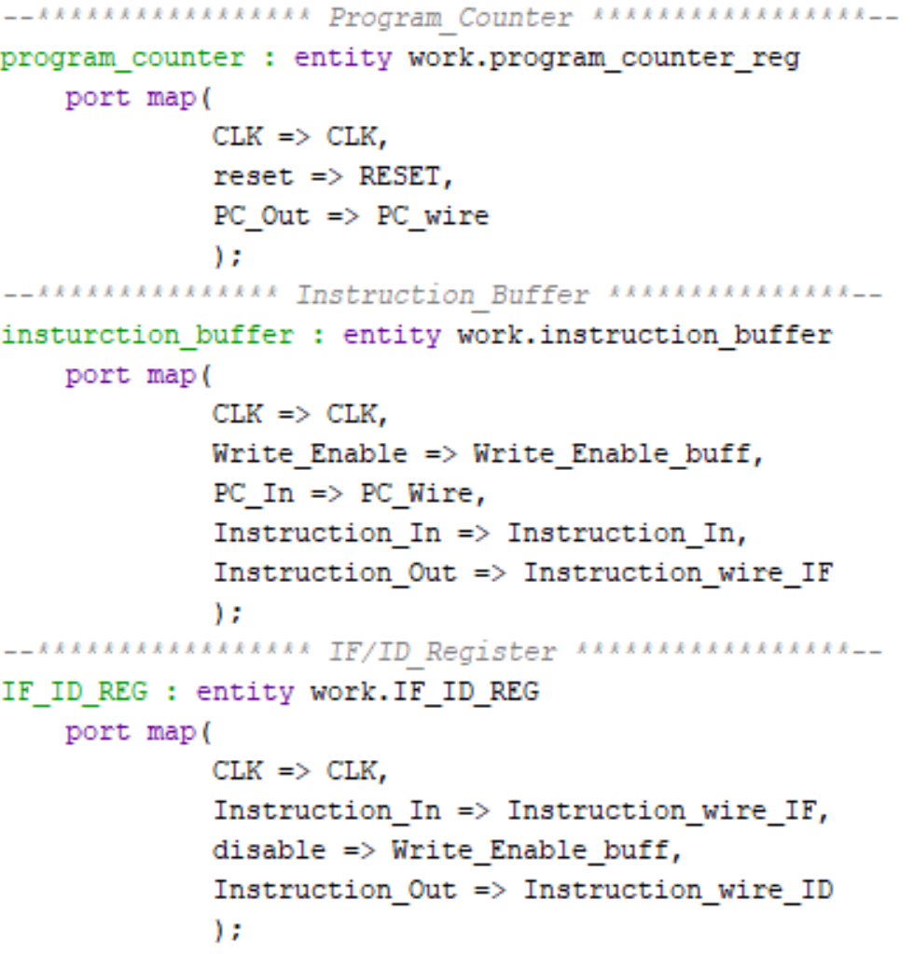
CODE
Multimedia Unit

Slide 22
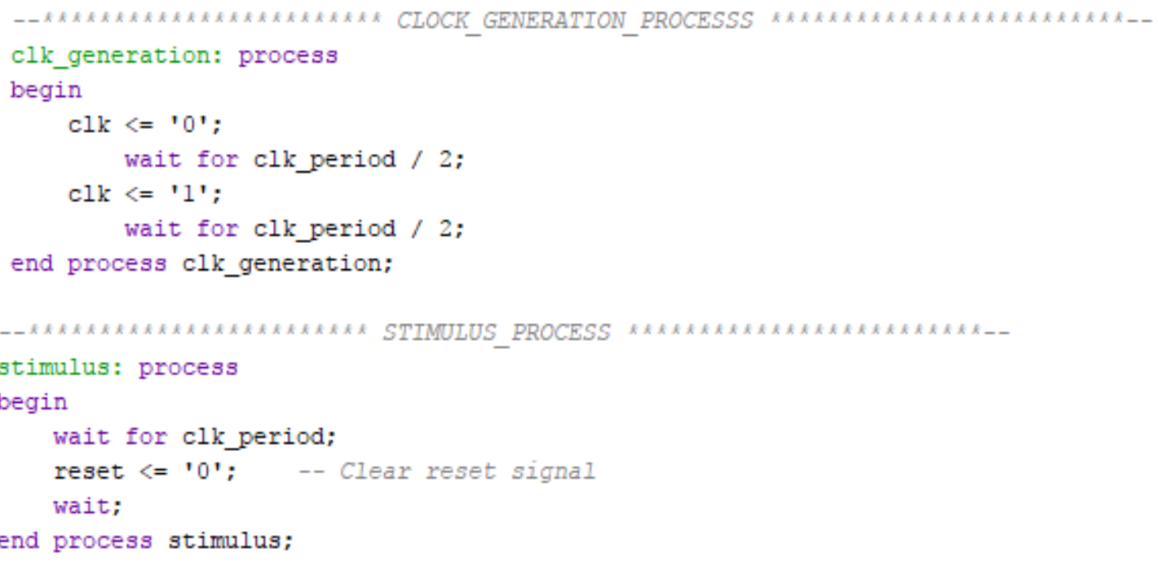
Testbench Code/Test Conditions
Program Counter

Slide 23
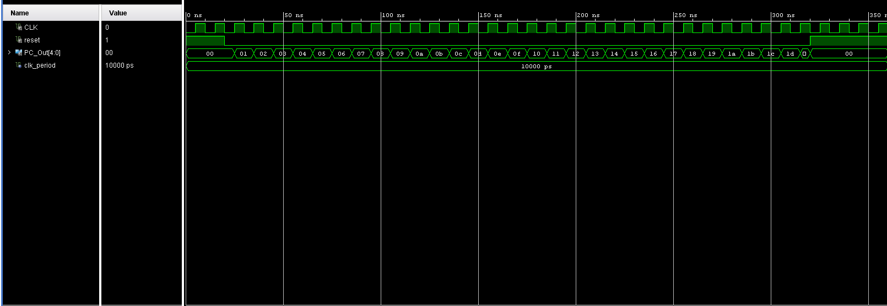

Slide 24
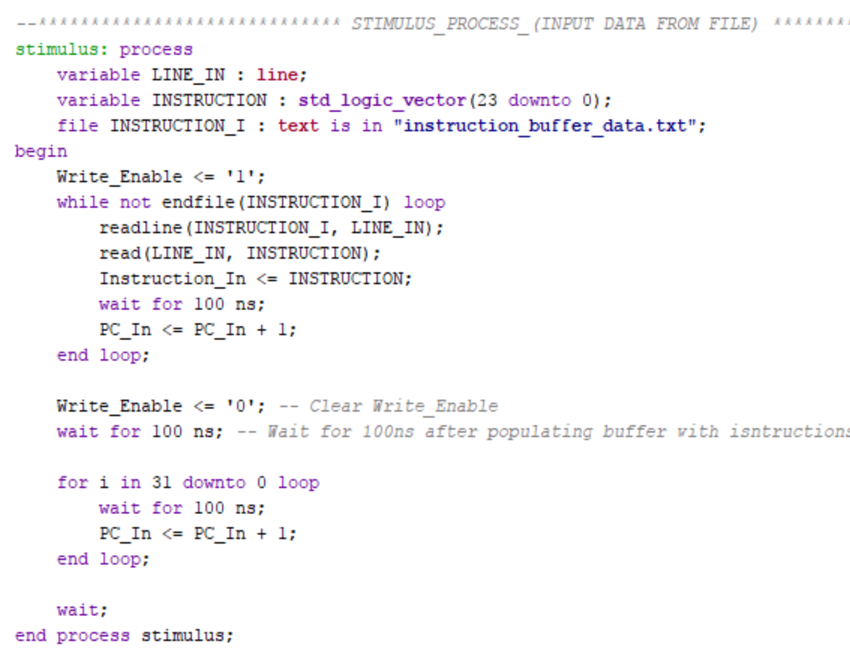
Testbench Code/Test Conditions
Instruction Buffer

Slide 25
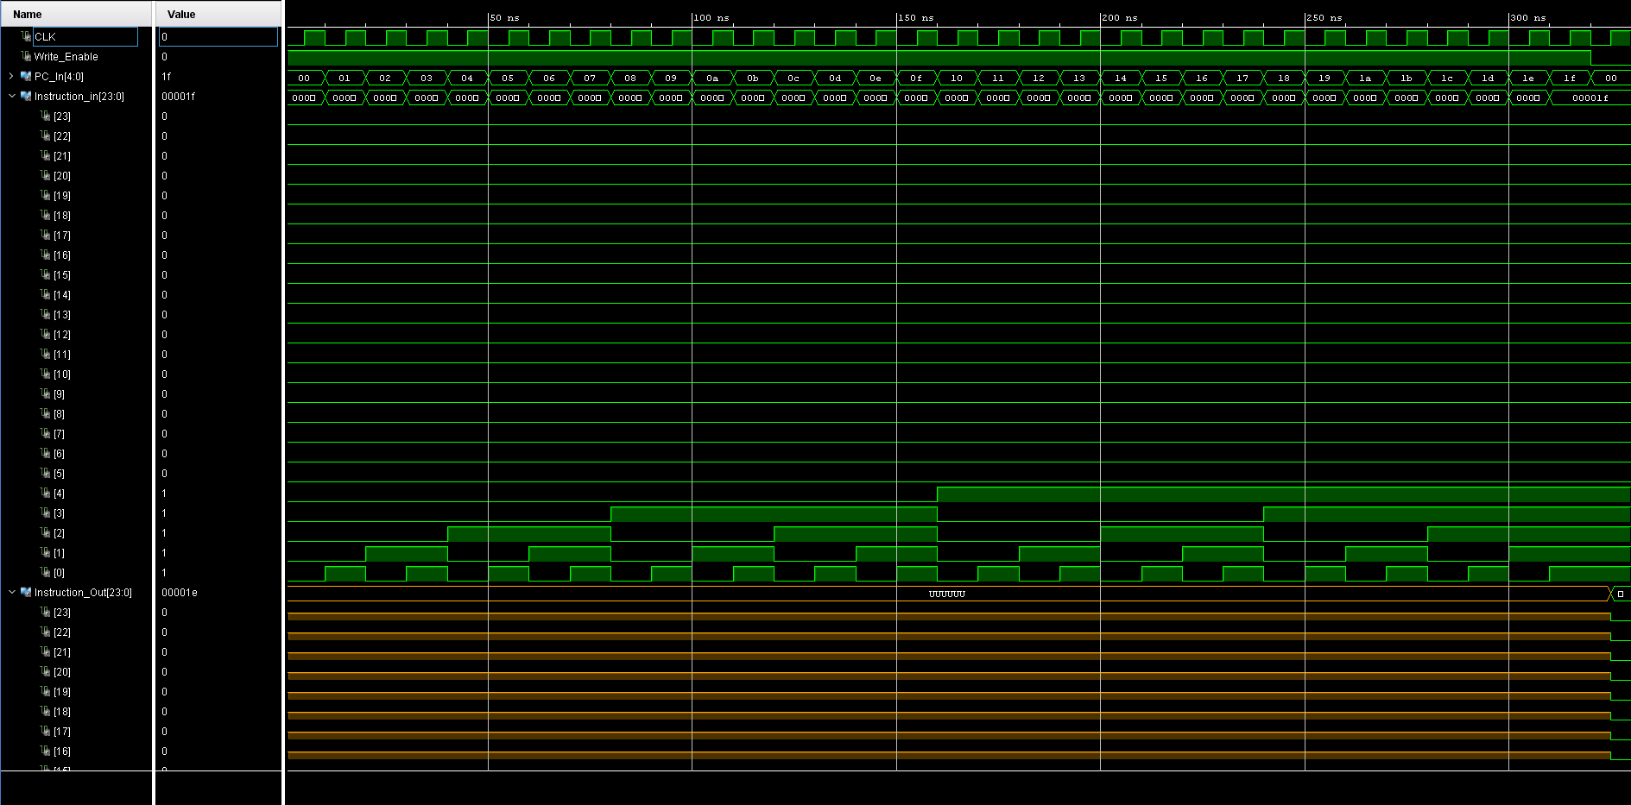

Slide 26
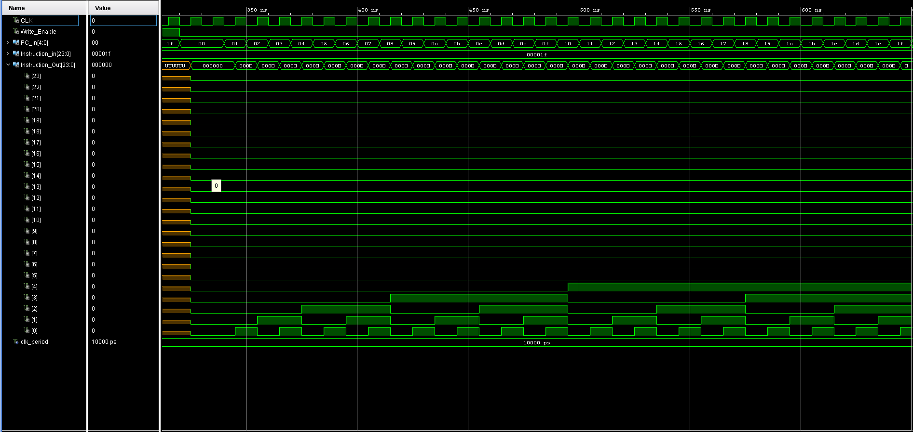

Slide 27
Testbench Code/Test Conditions
Instruction Decoder

Slide 28
Testbench Code/Test Conditions
Register File

Slide 29
Testbench Code/Test Conditions
Control Unit

Slide 30
Testbench Code/Test Conditions
Pipeline Registers

Slide 31
Testbench Code/Test Conditions
ALU 1

Slide 32
Testbench Code/Test Conditions
Load Immediate Shifter

Slide 33
Testbench Code/Test Conditions
ALU 2

Slide 34
Testbench Code/Test Conditions
Multimedia Unit

